Slide 1

Parallel and Distributed Computing
1. Introduction to domain

Slide 2
Course outline
Introduction to domain, terminologies, technologies
Architectures
Processes
Communications
Naming and coordination
Consistency and replication
Clusters and grids for parallel computing
Cloud platform
Service oriented architectures for distributed computing
Hands on Distributed systems- Hadoop and Spark
Data bricks
AWS
Google colab
Get ready for
4 quizzes and 4 assignments, mid term and final term examinations
1 quiz and 1 assignment will be unannounced

Slide 3
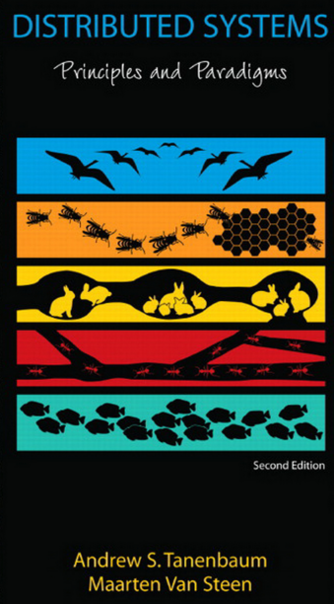
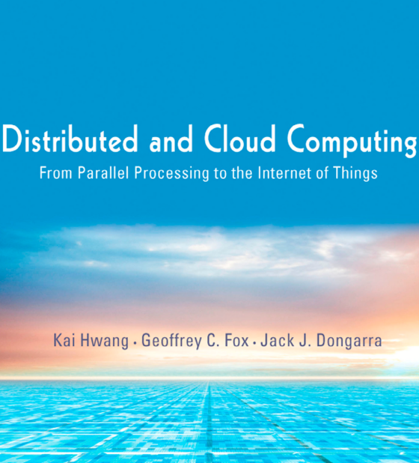
Text Books

Slide 4
What is Computing?
Why it becomes important?
Why is its need constantly increasing?
What the world has been doing in this regard?

Slide 5
Scalable computing---Over the internet
Over the past 60 years, computing technology has undergone a series of platform and environment changes.
evolutionary changes in machine architecture, operating system platform, network connectivity, and application workload.
Instead of using a centralized computer to solve computational problems,
a parallel and distributed computing system uses multiple computers to solve large-scale problems over the Internet.
Thus, distributed computing becomes data-intensive and network-centric.

Slide 6
Why Parallel Processing? The Age of Internet Computing
Billions of people use the Internet every day. As a result, supercomputer sites and large data centers must provide high-performance computing services to huge numbers of Internet users concurrently.
Because of this high demand, the Linpack Benchmark for high-performance computing (HPC) applications is no longer optimal for measuring system performance.
The emergence of computing clouds instead demands high-throughput computing (HTC) systems built with parallel and distributed computing technologies
We have to upgrade data centers using fast servers, storage systems, and high-bandwidth networks. The purpose is to advance network-based computing and web services with the emerging new technologies.

Slide 7
Quotes for parallel processing
“There are 3 rules to follow when parallelizing large codes. Unfortunately, no one knows what these rules are.”
~ Gary Montry
“The wall is there. We probably won’t have any more products without multicore processors but we see a lot of problems in parallel programming.” ~ Alex Bachmutsky
“We can solve the software crisis in parallel computing, but only if we work from the algorithm down to the hardware — not the traditional hardware-first mentality.” ~ Tim Mattson
“The processor industry is adding more and more cores, but nobody knows how to program those things. I mean, two, yeah; four, not really; eight, forget it.” ~ Steve Jobs

Slide 8
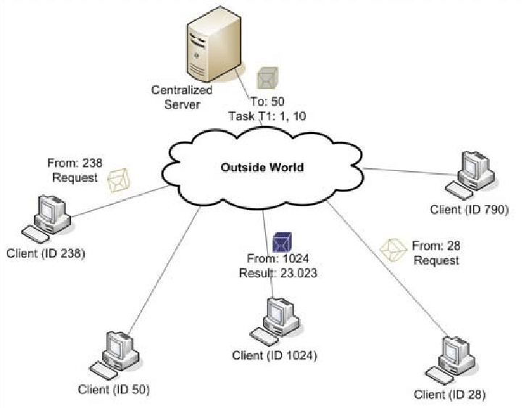
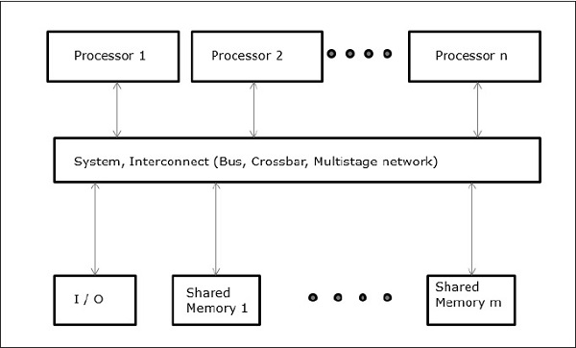
Computing Paradigms Terminology
Centralized
Parallel
Distributed
Cloud
Centralized computing
This is a computing paradigm by which all computer resources are centralized in one physical system. All resources (processors, memory, and storage) are fully shared and tightly coupled within one integrated OS. Many data centers and supercomputers are centralized systems, but they are used in parallel, distributed, and cloud computing applications.
Parallel computing
In parallel computing, all processors are either tightly coupled with centralized shared memory or loosely coupled with distributed memory. Some authors refer to this discipline as parallel processing. Inter-processor communication is accomplished through shared memory or via message passing. A computer system capable of parallel computing is commonly known as a parallel computer. Programs running in a parallel computer are called parallel programs. The process of writing parallel programs is often referred to as parallel programming .

Slide 9
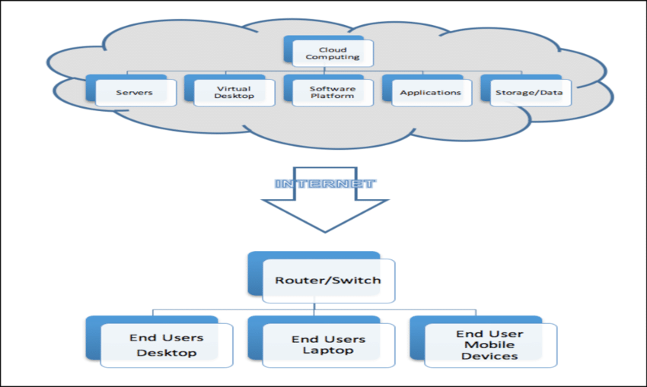
Computing Paradigms Distinction
Centralized
Parallel
Distributed
Cloud
Distributed computing
A distributed system consists of multiple autonomous computers, each having its own private memory, communicating through a computer network. Information exchange in a distributed system is accomplished through message passing. A computer program that runs in a distributed system is known as a distributed program. The process of writing distributed programs is referred to as distributed programming.
Cloud computing
An Internet cloud of resources can be either a centralized or a distributed computing system. The cloud applies parallel or distributed computing, or both. Clouds can be built with physical or virtualized resources over large data centers that are centralized or distributed. Some authors consider cloud computing to be a form of utility computing or service computing.

Slide 10
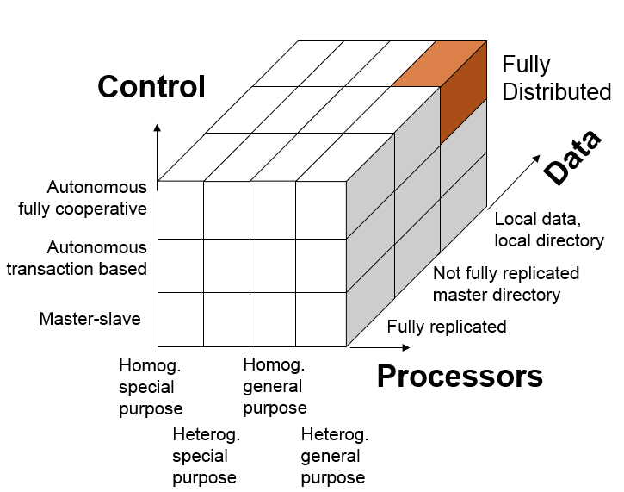
Fully Distributed System
Systems involve hardware (processors), application and system software (control) and application and system information (data).
Which of these dimensions have to be distributed for the system to be a distributed system?
Full hardware decentralization includes multiple heterogeneous control units (as opposed to a single control unit with multiple processors and multiple homogeneous control units).
Control must be provided by multiple units cooperating with each other rather than in a master-slave relationship
Data must be partitioned and/or replicated, each part with its own local directory.
definition is too restrictive in our opinion. Techniques of distributed system construction should also be employed if only a single dimension is decentralized.

Slide 11
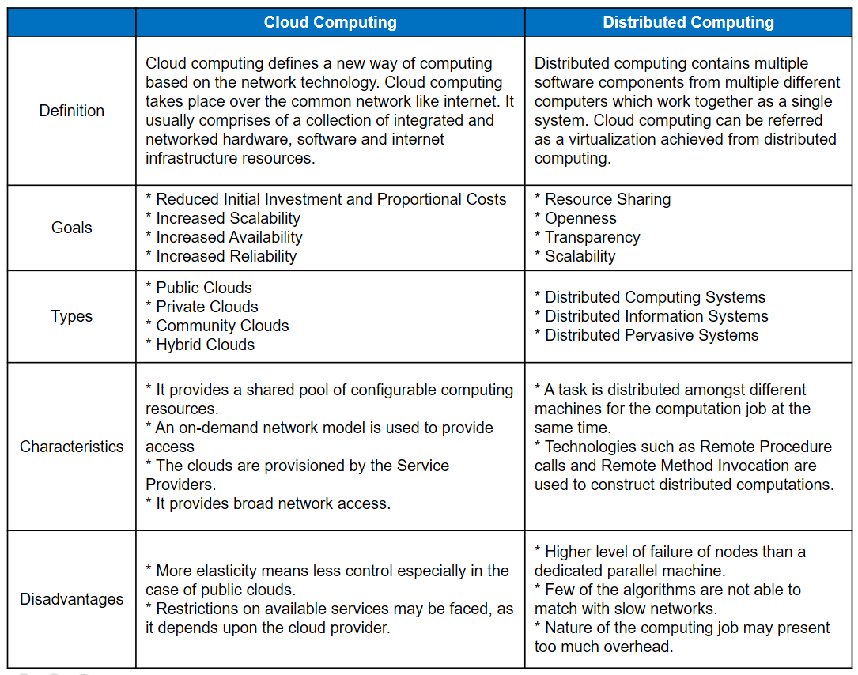

Slide 12
HPC and HTC
High performance computing
measured by floating-point speed in Linpack benchmark results.
However, the number of supercomputer users is limited to less than 10% of all computer users.
Today, the majority of computer users are using desktop computers or large servers when they conduct Internet searches and market-driven computing tasks.
High Throughput computing
pays more attention to high-flux computing. The main application for high-flux computing is in Internet searches and web services.
The performance goal thus shifts to measure high throughput or the number of tasks completed per unit of time.
HTC technology needs to not only improve in terms of batch processing speed, but also address the acute problems of cost, energy savings, security, and reliability at many data and enterprise computing centers.

Slide 13
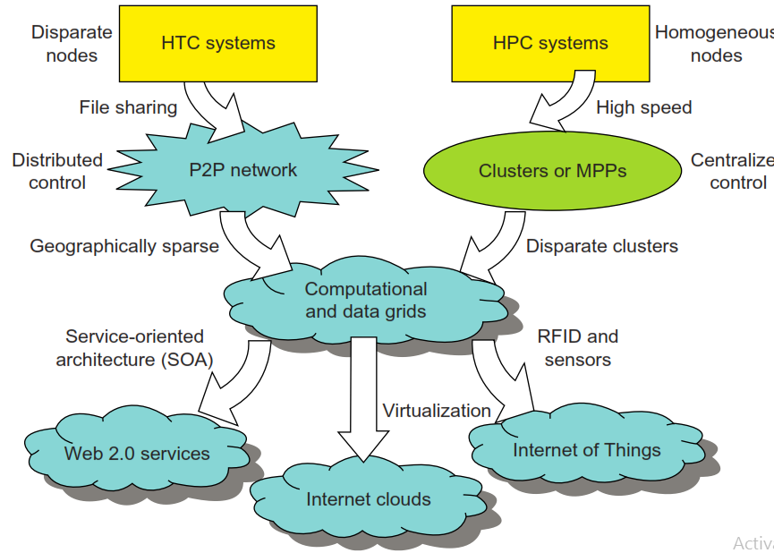
HTC Vs HPC
New Computing Paradigms
With the introduction of SOA, Web 2.0 services become available.
Advances in virtualization make it possible to see the growth of Internet clouds as a new computing paradigm.
The maturity of radio-frequency identification (RFID), Global Positioning System (GPS), and sensor technologies has triggered the development of the Internet of Things (IoT).
Figure 1.1 illustrates the evolution of HPC and HTC systems. On the HPC side, supercomputers (massively parallel processors or MPPs) are gradually replaced by clusters of cooperative computers out of a desire to share computing resources. The cluster is often a collection of homogeneous compute nodes that are physically connected in close range to one another.
(Distributed and cloud computing – from parallel processing to internet of things)

Slide 14
Three walls of HPC
Memory-wall challenge:
Memory already limits single-processor performance. How can we design a memory system that provides a bandwidth of several terabytes/s for data-intensive high-performance applications?
Power-wall challenge:
When there are millions of processing nodes, each drawing a few watts of power, we are faced with the energy bill and cooling challenges of MWs of power dissipation, even ignoring the power needs of the interconnection network and peripheral devices
Reliability-wall challenge:
Ensuring continuous and correct functioning of a system with many thousands or even millions of processing nodes is non-trivial, given that a few of the nodes are bound to malfunction at an given time

Slide 15
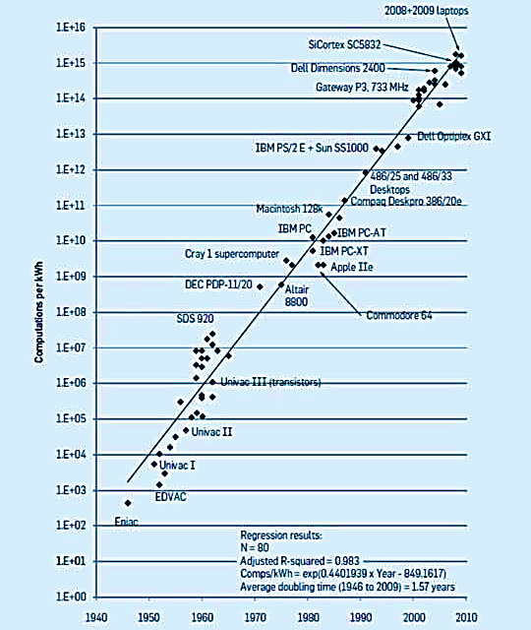
Power-Dissipation Challenge
A challenge at both ends:
- Supercomputers
- Personal electronics
Koomey’s Law:
Exponential improvement in energy-efficient computing, with computations performed per KWh doubling every 1.57 years
How long will Koomey’s law be in effect? It will come to an end, like Moore’s Law
https://cacm.acm.org/magazines/2017/1/211094-exponential-laws-of-computing-growth/fulltext

Slide 16
In the future, both HPC and HTC systems will demand multicore or many-core processors that can handle large numbers of computing threads per core. Both HPC and HTC systems emphasize parallelism and distributed computing.
Future HPC and HTC systems must be able to satisfy this huge demand in computing power in terms of throughput, efficiency, scalability, and reliability. The system efficiency is decided by speed, programming, and energy factors (i.e., throughput per watt of energy consumed). Meeting these goals requires to yield the following design objectives:
Efficiency measures the utilization rate of resources in an execution model by exploiting
massive parallelism in HPC. For HTC, efficiency is more closely related to job throughput, data
access, storage, and power efficiency.
Dependability measures the reliability and self-management from the chip to the system and
application levels. The purpose is to provide high-throughput service with Quality of Service
(QoS) assurance, even under failure conditions.
Adaptation in the programming model measures the ability to support billions of job requests
over massive data sets and virtualized cloud resources under various workload and service
models.
Flexibility in application deployment measures the ability of distributed systems to run well in
both HPC (science and engineering) and HTC (business) applications.

Slide 17
Scalable Computing Trends and New Paradigms
Degree of parallelism
Innovative applications
Towards utility computing
Hype cycle of new technologies

Slide 18
Scalable Computing Trends and New Paradigms
Degree of parallelism
Innovative applications
Towards utility computing
Hype cycle of new technologies
Degree of parallelism
Bit-level parallelism (BLP) – 50 years ago
Instruction-level parallelism (ILP) - 8, 16, 32 and 64 bit CPUs
practiced ILP through pipelining, superscalar computing, VLIW (very long instruction word) architectures, and multithreading
Data-level parallelism (DLP) was made popular through SIMD (single instruction, multiple data)
Task-level parallelism (TLP) used multicore processors and chip multiprocessors (CMPs)
Job- level parallelism (JLP) using distributed computing paradigms
As we move from parallel processing to distributed processing, we will see an increase in computing granularity to job-level parallelism (JLP)
A modern processor explores all of the aforementioned parallelism types. In fact, BLP, ILP, and DLP are well supported by advances in hardware and compilers. However, TLP is far from being very successful due to difficulty in programming and compilation of code for efficient execution on multicore CMPs.

Slide 19
Cyber Physical Systems
Degree of parallelism
Innovative applications
Towards utility computing
Hype cycle of new technologies
A cyber-physical system (CPS) is the result of interaction between computational processes and the physical world. A CPS integrates “cyber” (heterogeneous, asynchronous) with “physical” (concurrent and information-dense) objects. A CPS merges the “3C” technologies of computation, communication, and control into an intelligent closed feedback system between the physical world and the information world.

Slide 20
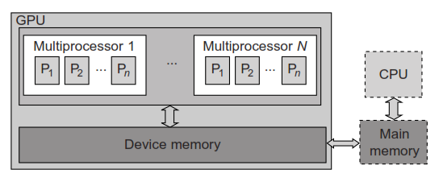
2. GPU Computing
How GPU works?
parallel execution of floating-point operations concurrently. The CPU is the conventional multicore processor with limited parallelism to exploit. The GPU has a many-core architecture that has hundreds of simple processing cores organized as multiprocessors.
The CPU instructs the GPU to perform massive data processing. The bandwidth must be matched between the on-board main memory and the on-chip GPU memory

Slide 21
3. Memory, Storage, and Wide-Area Networking
Multicore CPUs and Multithreading Technologies
GPU computing
Memory storage and WAN
Virtual Machines and Virtualization Middleware
Data Center Virtualization for Cloud Computing
Memory Technology
DRAM chip capacity from 16 KB in 1976 to 64 GB in 2011.
Memory wall problem persists ( Computing is getting more powerful w.r.t memory)
Faster processor speed and larger memory capacity result in a wider gap between processors and memory. The memory wall may become even worse a problem limiting the CPU performance in the future.
Wide area Networking

Slide 22
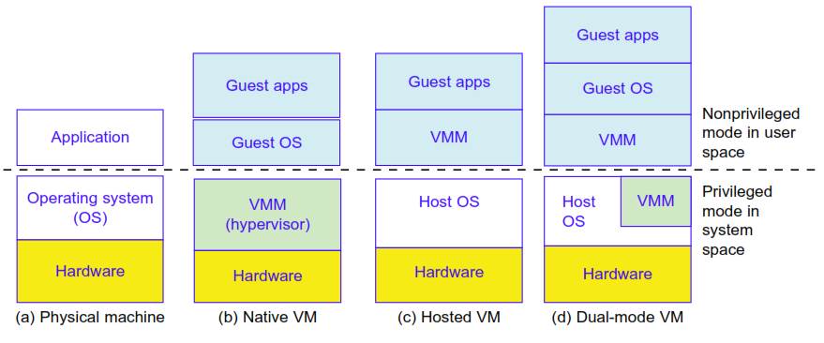
4. Virtual Machines and Virtualization Middleware
Multicore CPUs and Multithreading Technologies
GPU computing
Memory storage and WAN
Virtual Machines and Virtualization Middleware
Data Center Virtualization for Cloud Computing
A conventional computer has a single OS image. This offers a rigid architecture that tightly couples application software to a specific hardware platform. Some software running well on one machine may not be executable on another platform with a different instruction set under a fixed OS. Virtual machines (VMs) and Virtual machine manager (VMMs) offer novel solutions to underutilized resources, application inflexibility, software manageability, and security concerns in existing physical machines.

Slide 23
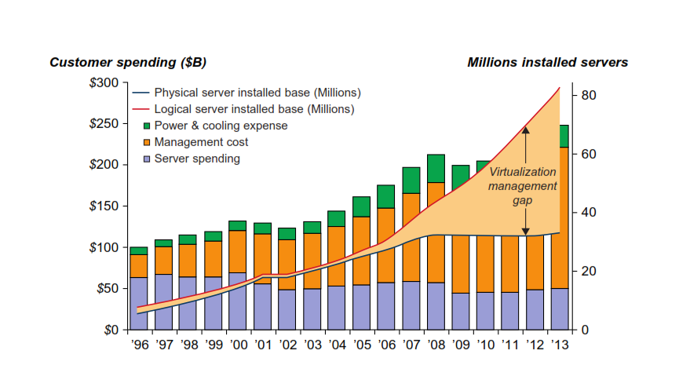
5. Data Center Virtualization for Cloud Computing
Multicore CPUs and Multithreading Technologies
GPU computing
Memory storage and WAN
Virtual Machines and Virtualization Middleware
Data Center Virtualization for Cloud Computing
Data Center Growth and Cost Breakdown
Low Cost-Design Philosophy
Convergence of technologies
Cloud computing is enabled by the convergence of technologies in four areas:
(1) hard- ware virtualization and multi-core chips,
(2) utility and grid computing,
(3) SOA, Web 2.0, and
(4) autonomic computing and data center automation.
Growth and cost breakdown of data centers over the years.

Slide 24
Performance Metrics and Scalability analysis
System throughput is often measured in MIPS, Tflops (tera floating-point operations per second),orTPS (transactions per second).
job response time and network latency. An interconnection network that has low latency and high bandwidth is preferred.
Other metrics can be
System overhead is often attributed to OS boot time, compile time, I/O data rate, and the runtime support system used.
QoS for Internet and web services; and
Security resilience for system defense against network attacks.

Slide 25
Basic Definitions
Elapsed Time
counts everything (disk and memory accesses, waiting for I/O, running other programs, etc.) from start to finish
a useful number, but often not good for comparison purposes
elapsed time = CPU time + wait time (I/O, other programs, etc.)
CPU time
doesn't count waiting for I/O or time spent running other programs
can be divided into user CPU time and system CPU time (OS calls)
CPU time = user CPU time + system CPU time
⇒ elapsed time = user CPU time + system CPU time + wait time

Slide 26
Amdahl's Law
Performance Metrics and Scalability analysis
In computer architecture, Amdahl's law (or Amdahl’s argument) is a formula which gives the theoretical speedup in latency of the execution of a task at fixed workload that can be expected of a system whose resources are improved.

Slide 27
Amdahl's Law
Suppose that enhancement E accelerates a fraction F of the task by a factor S, and the remainder of the task is unaffected
Time for Fraction F to be Enhanced by factor S
Execution time of the Fraction Enhanced
Original
Execution
Time of Task
Execution
Time
after fraction F
Enhanced by factor S

Slide 28
Amdahl's Law
Speedup due to enhancement E:
Ex Time without E
Speedup (E) =
Ex Time with E

Slide 29
Amdahl’s Law
Ex Time _{new} = Ex Time _{old} x (1 – Fraction _{enhanced}) + Fraction _{enhanced}
Speedup _{enhanced}

Slide 30
Amdahl’s Law
ExTime_{new} = ExTime_{old} x (1 - Fraction_{enhanced}) + Fraction_{enhanced}
Speedup_{enhanced}
1
ExTime_{old}
ExTime_{new}
Speedup_{overall} =
=
(1 - Fraction_{enhanced}) + Fraction_{enhanced}
Speedup_{enhanced}

Slide 31
Amdahl’s Law
Floating point instructions improved to run 2X; but only 10% of actual instructions are FP
ExTime_{new} =
Speedup_{overall}
=

Slide 32
Amdahl’s Law
Floating point instructions improved to run 2X; but only 10% of actual instructions are FP
ExTime_{new} = ExTime_{old} x (0.9 + .1/2) = 0.95 x ExTime_{old}
1
Speedup_{overall}
=
=
1.053
0.95

Slide 33
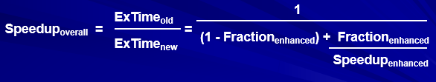
Amdahl’s Law
A processor spends 30% of its time on addition, 25% on mult, and 10% on division. Evaluate the following enhancements, each costing the same to implement:
Redesign of the adder to make it twice as fast.
Redesign of the multiplier to make it three times as fast.
Redesign the divider to make it 10 times as fast.
Solution
Adder redesign speedup = 1 / [0.7 + 0.3 / 2] = 1.18
Multiplier redesign speedup = 1 / [0.75 + 0.25 / 3] = 1.20
Divider redesign speedup = 1 / [0.9 + 0.1 / 10] = 1.10

Slide 34
Generalized Amdahl’s Law
Original running time of a program = 1 = f₁ + f₂ + . . . + f_{k}
New running time after the fraction f_{i} is speeded up by a factor p_{i}
f₁ f₂ f_{k}
+ + . . . +
p₁ p₂ p_{k}
Speedup formula
1
S =
f₁ f₂ f_{k}
+ + . . . +
p₁ p₂ p_{k}
If a particular fraction
is slowed down rather than speeded up,
use s_{j} f_{j} instead of f_{j} / p_{j} , where s_{j} > 1 is the slowdown factor

Slide 35

Reporting Computer Performance
Measured or estimated execution times for three programs.
 | Time on machine X | Time on machine Y | Speedup of Y over X
Program A | 20 | 200 | 0.1
Program B | 1000 | 100 | 10.0
Program C | 1500 | 150 | 10.0
All 3 prog’s | 2520 | 450 | 5.6
Analogy: If a car is driven to a city 100 km away at 100 km/hr and returns at 50 km/hr, the average speed…
is not (100 + 50) / 2
but is obtained from the fact that it travels 200 km in 3 hours.

